Slide 1

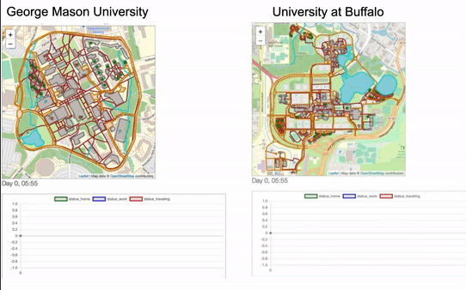
Agent-based Modeling and GIS with Python: The Mesa framework and its Geo extension
Mesa & Mesa-Geo
Mesa is an open-source agent-based modeling (ABM) framework written in Python, allowing users to quickly build and visualize agent-based models.
Mesa-Geo is its GIS extension. Thanks to the modular design of Mesa, extending its functionalities is relatively straight-forward, without the necessity of modifying its core components.
Example: Agents & Networks
Batch Runner
Model
Visualization Server
Browser Page
Scheduler
Space
Space Module
Space Module (js)
Chart Module
Chart Module (js)
GeoSpace
GeoSpace Module
GeoSpace Module (js)
Agent
GeoAgent
Mesa module
Data Collector
Mesa-Geo module
Why this is important
There has been a trend of utilizing machine learning methods in and for ABM and GIS.
Python is currently the dominant programming language for machine learning (ML): NumPy, pandas, scikit-learn, Keras, PyTorch, and of growing interest to GIScience (PySAL, GeoPandas, Rasterio ...).
Mesa-Geo lacks ABM, GIS and ML integration.
Next steps
Implement more functions into Mesa-Geo
Improve communication efficiency between backend visualization server and frontend browser page
Documentation, test cases, issue templates …
Boyu Wang

